Slide 1
PERSONALIZED MUSIC RECOMMENDATION SYSTEM
SUBMITTED BY
RUPAM DEY
REG NO:030947
AND
KHUSAL DAS
REG NO: 201000100120003
Under the Guidance of
MR. SUBHANJAN SARKAR
Assistant Professor,
Department of Computer Science & Engineering,
Maulana Abul Kalam Azad University of Technology, WB
Nadia-741249, W.B., India

Slide 2
INDEX
1)INTRODUCTION
1
2)MOTIVATION FOR WORK
2
3)FEATURES
3
I)CORE RECOMMENDATIONS FEATURES
4
II)UX RELATED FEATURES
5
4)FUTRE WORK
6

Slide 3
INTRODUCTION
With the rise of digital content distribution, we have access to a huge music collection. With millions of songs to choose from, we sometimes feel overwhelmed. Thus, an efficient music recommender system is necessary in the interest of both music service providers and customers.
Our music recommendation is large-scale and personalized. In this system, the user can get songs of their preferred recommendation.

Slide 4
WHY RECOMMENDATION SYSTEM
Music dataset is too big while life is short!!!! You need someone to teach you how to manage and give you wise suggestions according to your taste!
Music service providers need a more efficient system to attraction their clients

Slide 5
MOTIVATION FOR WORK
1.WE ARE AIMMING TO BUILD A PERSONALIZED RECOMMENDATION SYSTEM
2. CONTROL IN THE USER’S HAND
3.USER FRIENDLY INTERFACE
4.PROVIDE CUSTOMIZABLE THINGS.

Slide 6
PROJECT OBJECTIVE
The objective of our project to develop a personalized music recommendation web app. Our aim is to provide users with a system where they can choose the mode of recommendation by themself.

Slide 7
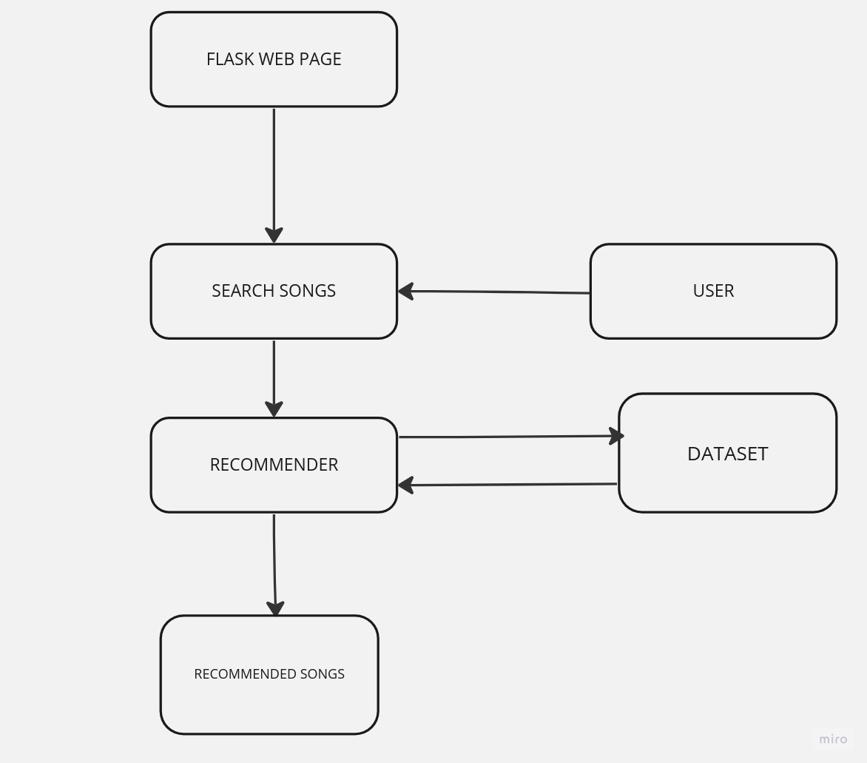
OUR TASK

Slide 8
FEATURES
I)Core Recommendations Features​
II)Ux Related Features

Slide 9
CORE RECOMMENDATION FEATURES

Slide 10
MODES OF RECOMMENDATIONS
i)Keep up with what's trending : SUGGEST MORE POPULAR SONGS
ii)Discover hidden gems: Suggest less popular songs

Slide 11
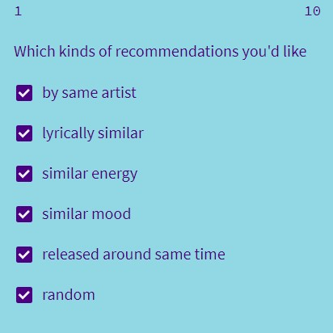
TYPES OF RECOMMENDATIONS
I) By same artists
II) Lyrically similar
III) Similar energy
Iv) Similar mood
v) Release around same time
vi) Random

Slide 12
UX RELATED FEATURES

Slide 13
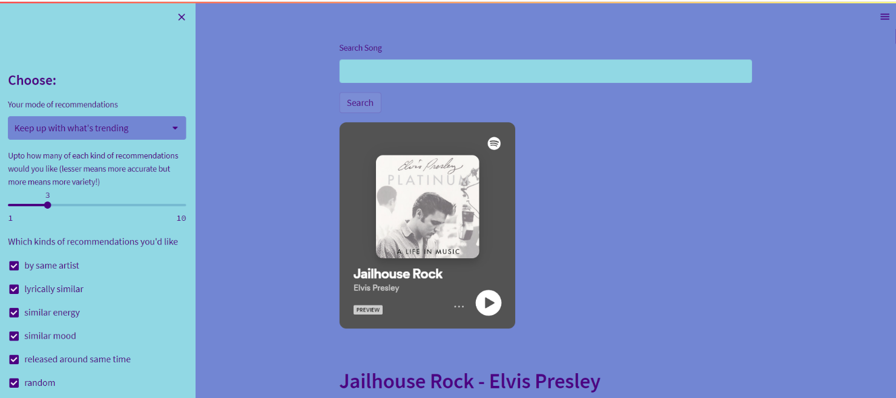
PRETTY AND FUNCTIONAL UI
I)Ability to show or hide the lyrics for each song
II)Viewing a recommended song by clicking on the listen button, will then lead to recommendations based on that song
III)Ability to choose between a custom (pastel), light and dark theme.
IV)Handy hamburger menu with options to report a bug, share the web app, view source code, read about it, see credits, etc
V)Cross Platform & Responsive

Slide 14
FUTURE WORK
I) DATA ENHANCEMENT
II)PERSONALIZATION
III)IMPLEMENT CONTENT BASED FILTERING
IV)IMPLEMENT COLLABORATIVE FILTERING
V)LOGIN PAGE

Slide 15
THANK YOU !!!!

